Slide 1
Camera Web UI proposal for FOTA
Date : 2019/10/31
Version: v1.1
By: Carrie Lee

Slide 2
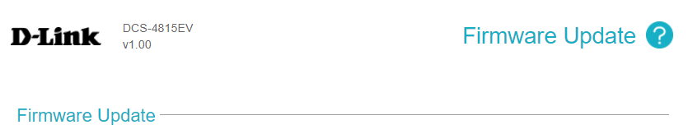



Camera Web UI – Firmware Upgrade
Firmware Upgrade
Firmware Upgrade
Current Version 1.00
Latest Version 1.01
Release Note
Check Latest Version
Upgrade Now
Auto Check Latest Version
Auto Upgrade
Monday
* The device must be connected to the internet to perform above process.
Manual Upgrade
Select File

Slide 3
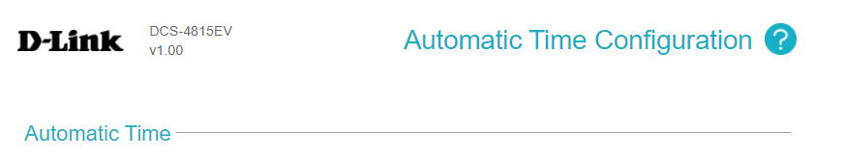
Camera Web UI – Automatic Time Configuration
Automatic Time Syn.
Time Zone Update
Asia / Taipei
Upgrade Now
NTP
Ntp.dlink.com.tw
* The device must be connected to the internet to perform above process.
Notes:
Auto UTC offset and daylight saving rule synchronization

Slide 4
Description – Firmware Upgrade
Current Version
Display current FW version
Latest Version
Display the latest FW version
Synchronize with FOTA server while device boot up and every 7 days from on boot
: Highlight to user for FW upgrade if current FW is not the latest one
Release Note:
Click to get the release note of the latest FW
Check Latest Version:
Click to check the latest FW version manually
Upgrade Now
Click to upgrade the latest FW
Popup message as below
Are you sure to upgrade FW?
□ Confirm □ Cancel
Downloading …………..
□ Cancel 7M/20M
Updating ………
6
(Downloading FW)
(Updating FW)

Slide 5
Description – Firmware Upgrade
Auto Check Latest Version
Enable/Disable to check the latest FW version automatically [Default: Disable]
When this feature is enable, popup message will be shown in front of live view while user link web UI
Auto Upgrade
Enable/Disable to upgrade FW automatically [Default: Disable]
Upgrade Time: Select time 00:00~23:59 and week Monday ~ Sunday from dropdown list
Manual Upgrade:
Click [Select File] to select the desired FW for upgrade
Critical Update Available
A critical firmware update is available. An immediate upgrade to this version is recommended in order to ensure optimal device operation.
Please make sure the device is powered, and do not power cycle the device during the upgrade process.
□ Update now □ Remind me later
New Firmware Available for Update
Please make sure the device is powered, and do not power cycle the device during the upgrade process.
□ Update now □ Remind me later
(Applied for the FW with Enforced status)

Slide 6
Description – Automatic Time Configuration
Time Zone Update
Enable/Disable to auto sync UTC offset and daylight saving rule on boot [Default: Disable]
Select time zone from dropdown list [Default: Asia / Taipei]
NTP
Enable/Disable to auto sync NTP server while device boot up and and every ?? Day on boot [Default: Disable]
Select D-Link NTP server from drop box or input user’s NTP server
D-Link NTP server: ntp1.dlink.com, ntp.dlink.com.tw

Slide 7
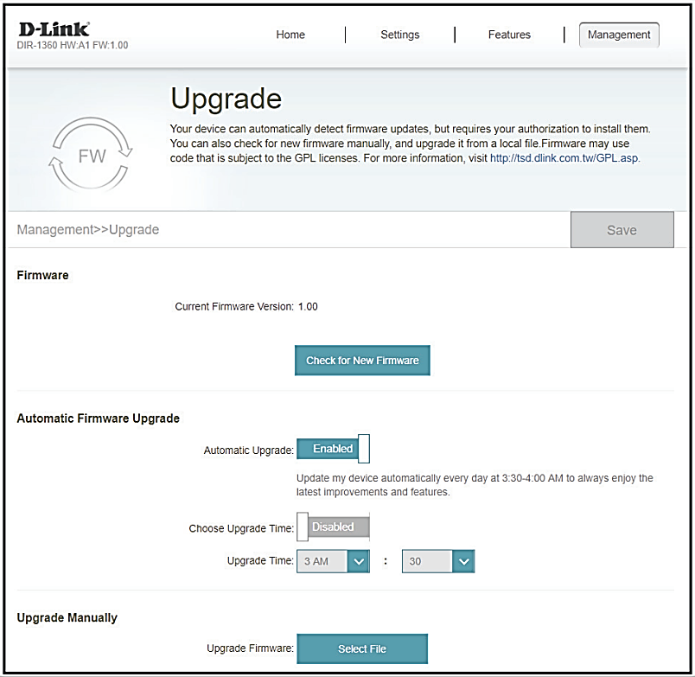
Reference UI_DIR-2660

